Slide 1
Interactive Story Form Learning
September 2012

Slide 2
Education Today
Limited Resources
Dynamic Environments
Student Specific Strategies
Increased Technology
Progressive Engagement

Slide 3
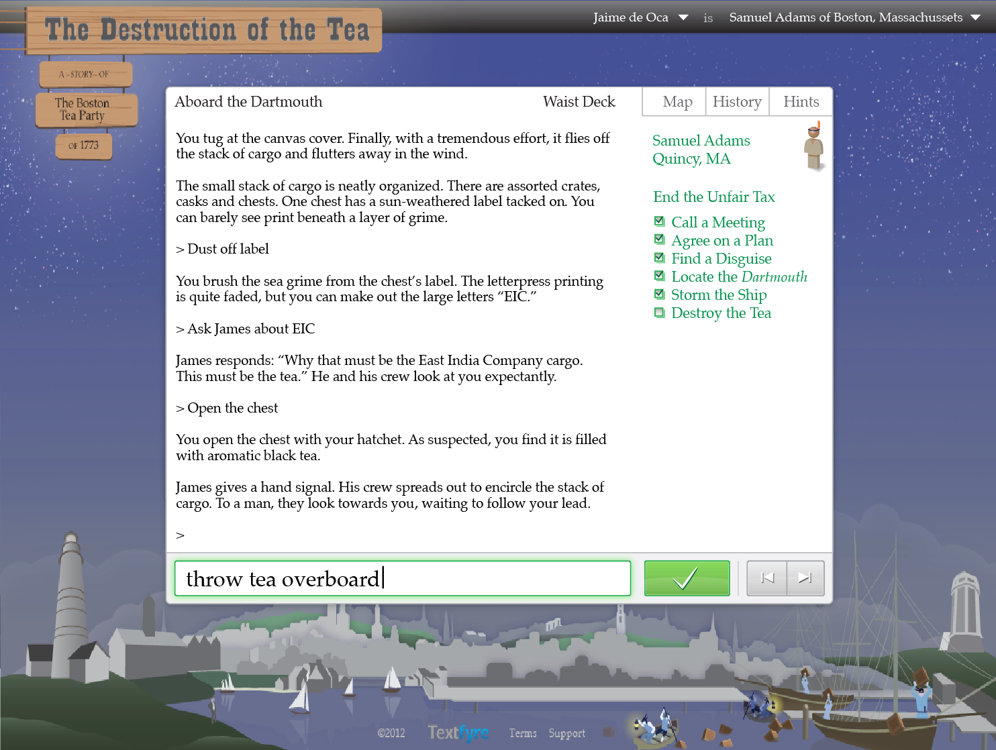

Slide 4
Textfyre Is…
Non-Fiction Content
Educational Games
Interactive Reading
Common Core Standards Focused
Assessment Friendly
Technology Driven
Textfyre is a proven story form platform first used in 2009.

Slide 5
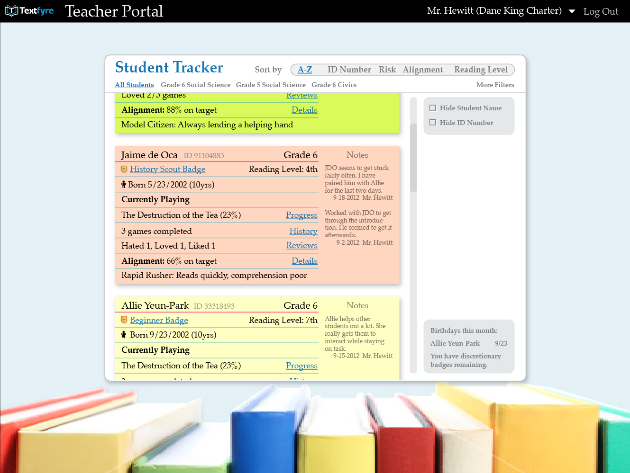
Teacher Dashboard

Slide 6
Teacher Dashboard

Slide 7
Teacher Dashboard

Slide 8
The Problems
Students
Teachers
Administrators
Not meeting minimal grade standards
Not engaged
Assessment of student performance is untimely and inconclusive
Need accurate statistics and measurable feedback

Slide 9
Solution
Students
Teachers
Administrators
Actively
engaged with individual attention
Get feedback instantly for fast student assessment
See measurable growth with tools to track progress

Slide 10
Interactive Story Form
Benefits
Students
Teachers
Administrators
Engaging
Entertaining
Dynamic
Reading Leveled
Social
Blind Testing
Maps To CCS*
Enables Flipping
Instant Feedback
Instant Feedback
Teacher Assessment
Aggregate Data
Digitally Delivered
* Common Core Standards

Slide 11
Technology
Virtual machine game engine
Natural language parser
Natural world model
Artificial intelligence characters
Embedded scholastic resources
Teacher-controlled social networking
we create engaging story-based experiences

Slide 12
Target Market
Key Market Statistics - Students | Nationwide | Illinois
Grade 6, 7 and 8 Students enrolled in Public School (2010) | 10.9 Million | 463,569
Grade 6, 7 and 8 Students enrolled in Private School (2010) | 1.0 Million | 50,831
Key Market Statistics - Schools | Nationwide | Illinois
Public Schools with Grade 6, 7 and 8 enrollment (2010) | 95,850 | 4,169
School Districts with Grade 6, 7 and 8 enrollment (2010) | 14,884 | 847

Slide 13
Competition/Peers
All have significant foothold in the Adaptive Learning market. Textfyre seeks to apply its story form interactive approach in ways not fully used by others.

Slide 14
Why Textfyre?
Builds on existing technology
Maps to common core standards
Actively engages students by building on interactivity which is part of children's lives in and out the classroom
Addresses underserved middle-school market
Provides immediate feedback on student, class and multiple class results

Slide 15
Timeline
Spring 2013 – Pilot in classrooms
Complete 2-3 working story modules
Test in 3 diverse schools, 2 classrooms each
Collect feedback & measure achievement
Compile summary findings report
Summer 2013 Prelaunch Phase
Fall 2013 Launch Phase -Introduce in Chicago area schools
Fall 2014 Roll out to target markets

Slide 16
Next Steps
Pilot
Complete pilot story
Define pilot parameters and protocols
Gain pilot schools/class commitments
Run pilot playtests
Compile results
Refinement
Adjust product based on pilot results
User Testing
Stakeholder feedback (teachers, admin., others)

Slide 17
Future
Future opportunities:
Establish Interfaces (LMS, Research)
English as a Second Language
Expanded Subject Matter

Slide 18
THANK YOU!
Please direct questions and comments to:
David Cornelson David@Textfyre.com 630.803.4302
or

